Slide 1
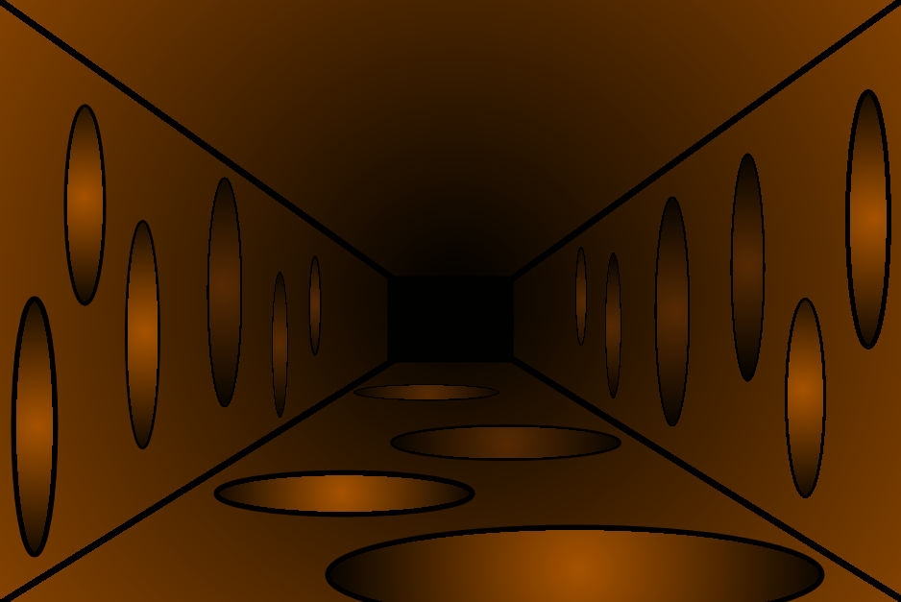




SUPER HERO ACADEMY
GREEN MEANIE

Slide 2
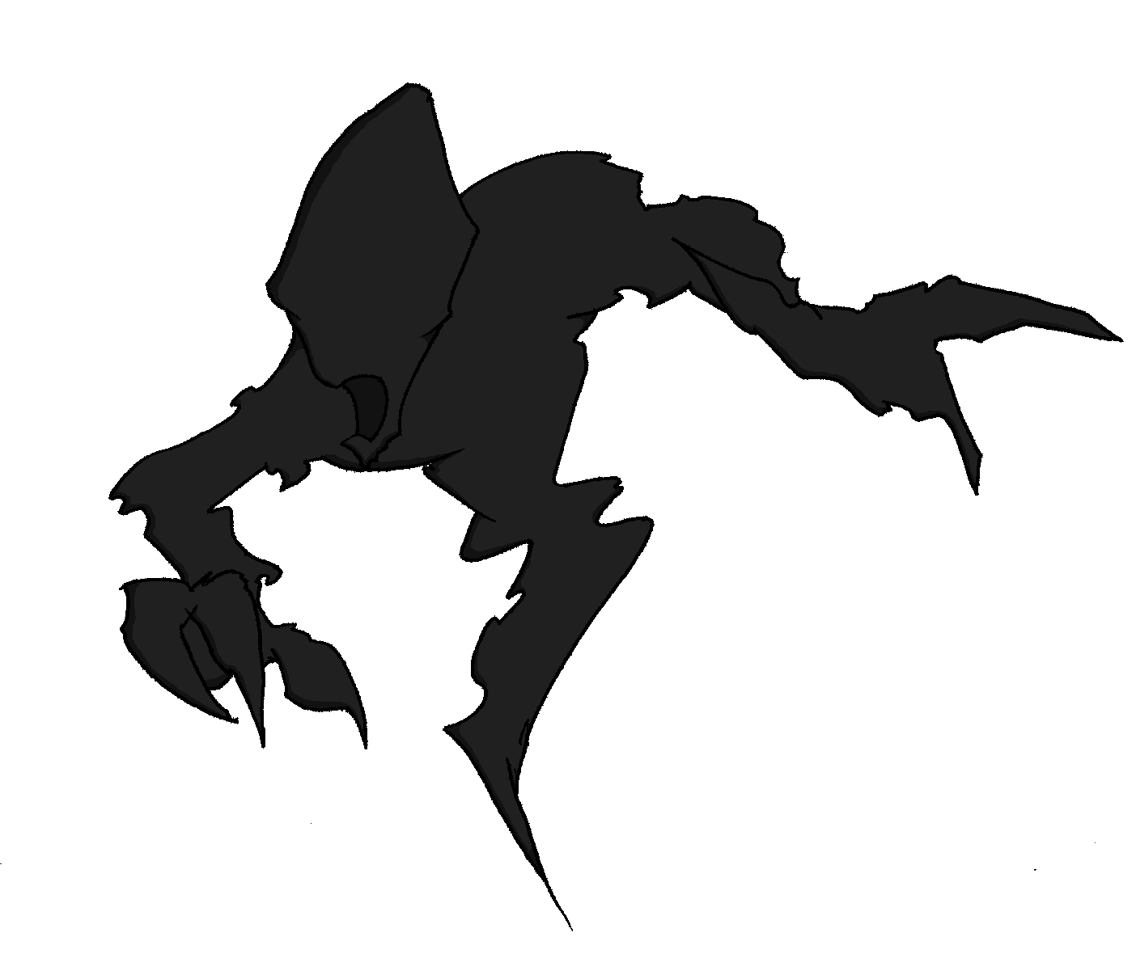

SUPER HERO ACADEMY
BYSTANDER EFFECT
BYSTANDER EFFECT
+ 1 Upstander Power Point
SUPER HERO ACADEMY
– 2 Upstander Power Points

Slide 3
SUPER HERO ACADEMY
BYSTANDER EFFECT

Slide 5
SUPER HERO ACADEMY
GREEN MEANIE
SUPER HERO ACADEMY
– 1 Upstander Power Point
GREEN MEANIE
+ 3 Upstander Power Points

Slide 6
SUPER HERO ACADEMY
GREEN MEANIE
GREEN MEANIE
+ 6 Upstander Power Points
SUPER HERO ACADEMY
– 1 Upstander Power Point

Slide 7

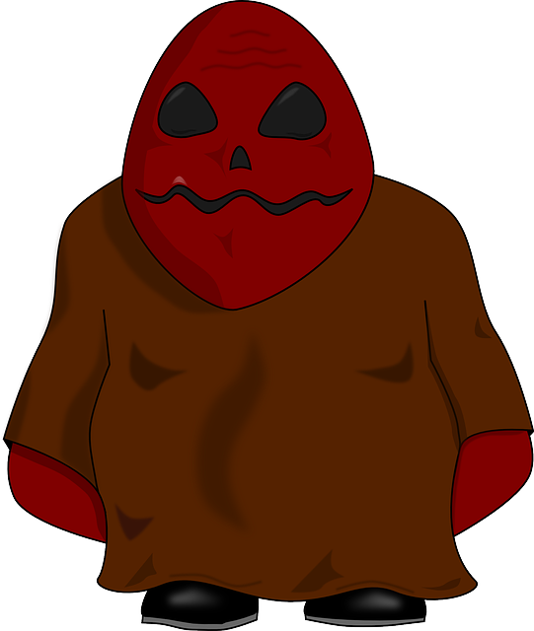
SUPER HERO ACADEMY
PUMPKIN HEAD
SUPER HERO ACADEMY
– 1 Upstander Power Point
PUMPKIN HEAD
+ 6 Upstander Power Points

Slide 8
SUPER HERO ACADEMY
GREEN MEANIE
SUPER HERO ACADEMY
– 1 Upstander Power Point
GREEN MEANIE
+ 3 Upstander Power Points

Slide 9
SUPER HERO ACADEMY
PUMPKIN HEAD
SUPER HERO ACADEMY
– 2 Upstander Power Point
PUMPKIN HEAD
+ 2 Upstander Power Points

Slide 10
SUPER HERO ACADEMY
PUMPKIN HEAD
SUPER HERO ACADEMY
– 2 Upstander Power Points
PUMPKIN HEAD
+ 6 Upstander Power Points

Slide 12
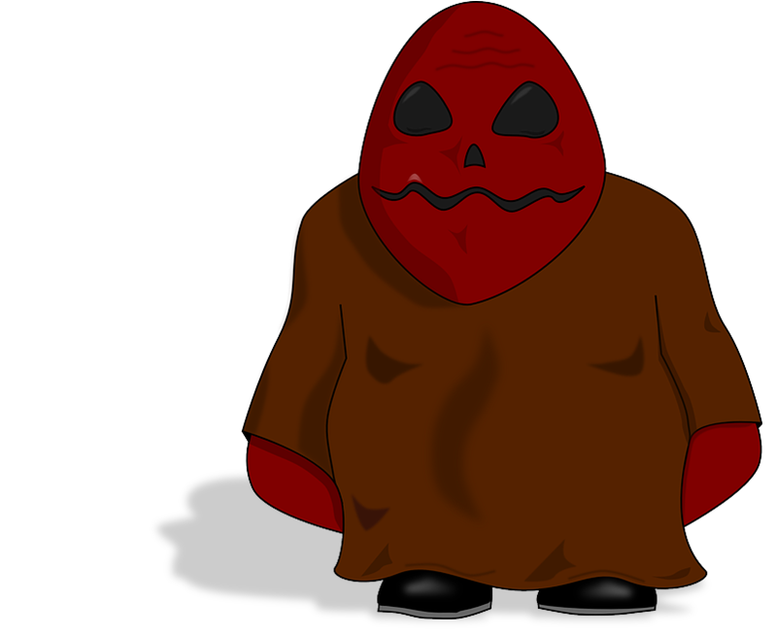
SUPER HERO ACADEMY
RED BOLTS
SUPER HERO ACADEMY
– 3 Upstander Power Points
RED BOLTS
+ 3 Upstander Power Points

Slide 13
SUPER HERO ACADEMY
PUMPKIN HEAD
SUPER HERO ACADEMY
– 2 Upstander Power Points
PUMPKIN HEAD
+ 3 Upstander Power Points

Slide 14
SUPER HERO ACADEMY
RED BOLTS
SUPER HERO ACADEMY
– 3 Upstander Power Points
RED BOLTS
+ 6 Upstander Power Points

Slide 15
SUPER HERO ACADEMY
PUMPKIN HEAD
SUPER HERO ACADEMY
– 2 Upstander Power Points
PUMPKIN HEAD
+ 2 Upstander Power Points

Slide 21
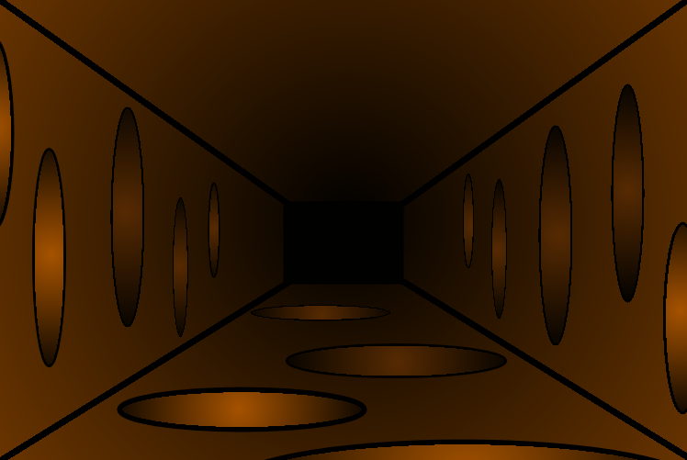

Slide 22


Slide 23
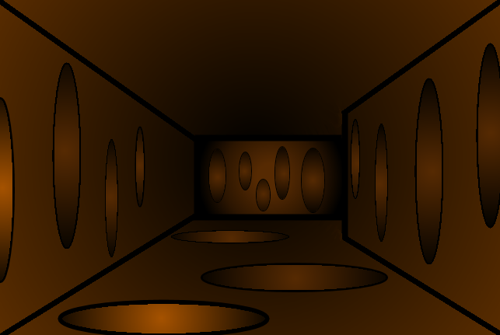

Slide 24
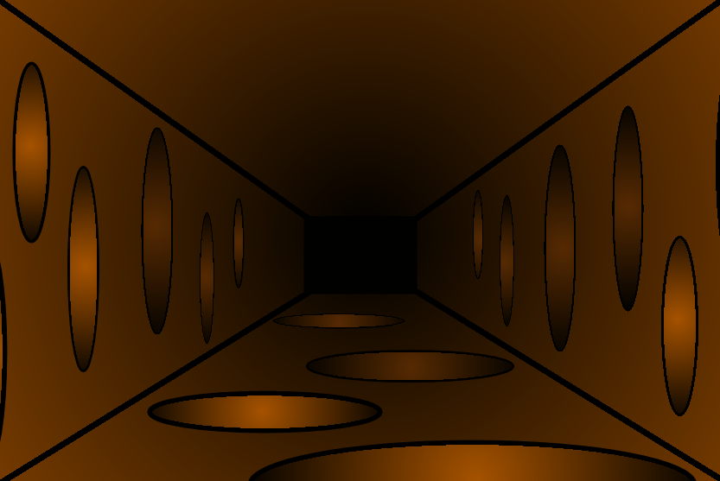

Slide 29
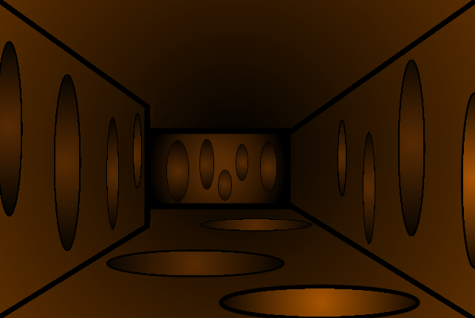

Slide 30
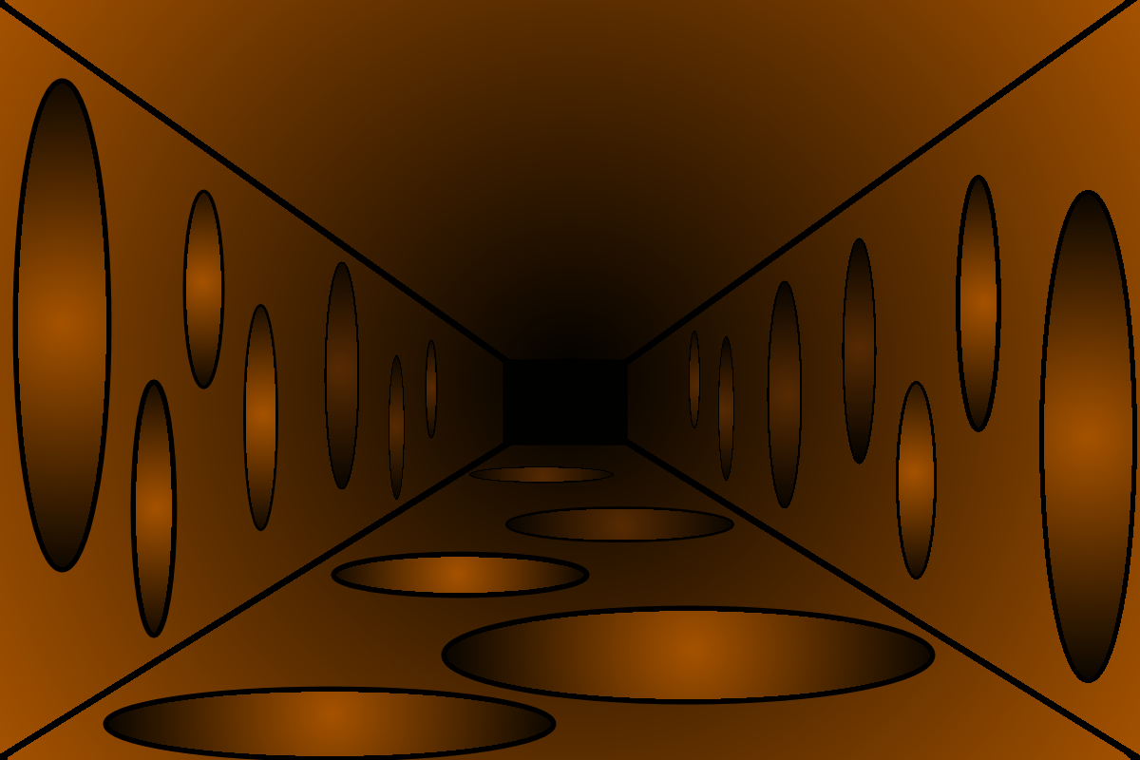

Slide 31
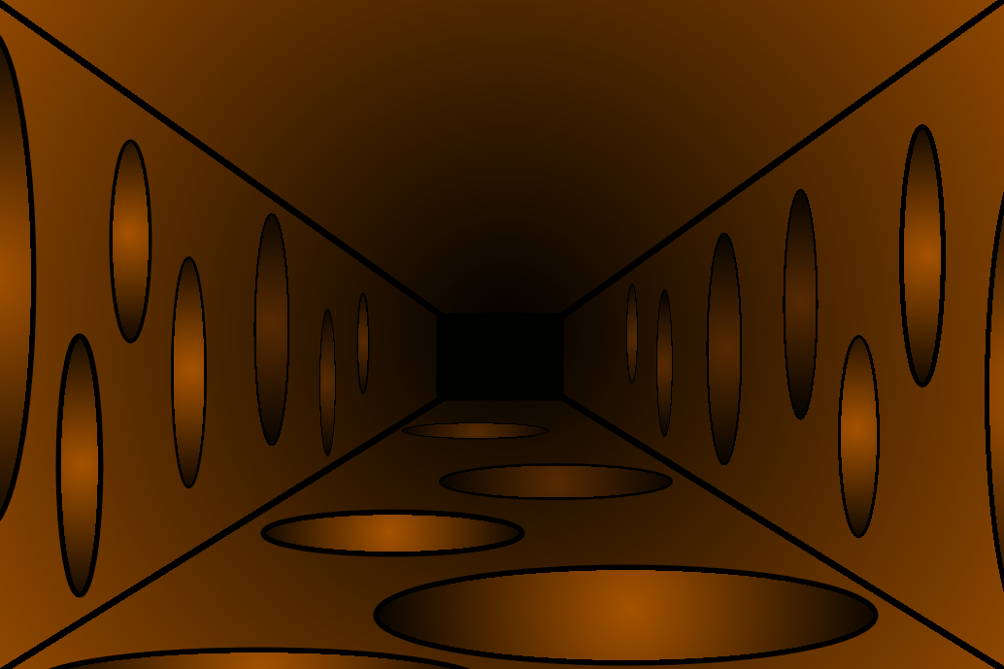

Slide 33
SUPER HERO ACADEMY
GREEN MEANIE
SUPER HERO ACADEMY
– 1 Upstander Power Point
GREEN MEANIE
+ 3 Upstander Power Points

Slide 39
SUPER HERO ACADEMY
GREEN MEANIE
GREEN MEANIE
+ 6 Upstander Power Points
SUPER HERO ACADEMY
– 1 Upstander Power Point

Slide 43
SUPER HERO ACADEMY
PUMPKIN HEAD
SUPER HERO ACADEMY
– 1 Upstander Power Point
PUMPKIN HEAD
+ 6 Upstander Power Points

Slide 67
SUPER HERO ACADEMY
GREEN MEANIE
SUPER HERO ACADEMY
– 1 Upstander Power Point
GREEN MEANIE
+ 3 Upstander Power Points

Slide 70
SUPER HERO ACADEMY
PUMPKIN HEAD
SUPER HERO ACADEMY
– 2 Upstander Power Point
PUMPKIN HEAD
+ 2 Upstander Power Points

Slide 78
SUPER HERO ACADEMY
PUMPKIN HEAD
SUPER HERO ACADEMY
– 2 Upstander Power Points
PUMPKIN HEAD
+ 6 Upstander Power Points

Slide 84
SUPER HERO ACADEMY
RED BOLTS
SUPER HERO ACADEMY
– 3 Upstander Power Points
RED BOLTS
+ 3 Upstander Power Points

Slide 86
SUPER HERO ACADEMY
PUMPKIN HEAD
SUPER HERO ACADEMY
– 2 Upstander Power Points
PUMPKIN HEAD
+ 3 Upstander Power Points

Slide 96
SUPER HERO ACADEMY
RED BOLTS
SUPER HERO ACADEMY
– 3 Upstander Power Points
RED BOLTS
+ 6 Upstander Power Points

Slide 100
SUPER HERO ACADEMY
PUMPKIN HEAD
SUPER HERO ACADEMY
– 2 Upstander Power Points
PUMPKIN HEAD
+ 2 Upstander Power Points

Slide 105
SUPER HERO ACADEMY
GREEN MEANIE
SUPER HERO ACADEMY
– 1 Upstander Power Point
GREEN MEANIE
+ 3 Upstander Power Points

Slide 111
SUPER HERO ACADEMY
GREEN MEANIE
GREEN MEANIE
+ 6 Upstander Power Points
SUPER HERO ACADEMY
– 1 Upstander Power Point

Slide 114
SUPER HERO ACADEMY
PUMPKIN HEAD
SUPER HERO ACADEMY
– 2 Upstander Power Points
PUMPKIN HEAD
+ 6 Upstander Power Points

Slide 115
SUPER HERO ACADEMY
PUMPKIN HEAD
SUPER HERO ACADEMY
– 2 Upstander Power Point
PUMPKIN HEAD
+ 2 Upstander Power Points

Slide 117
SUPER HERO ACADEMY
GREEN MEANIE
SUPER HERO ACADEMY
– 1 Upstander Power Point
GREEN MEANIE
+ 3 Upstander Power Points

Slide 120
SUPER HERO ACADEMY
PUMPKIN HEAD
SUPER HERO ACADEMY
– 1 Upstander Power Point
PUMPKIN HEAD
+ 6 Upstander Power Points

Slide 124
SUPER HERO ACADEMY
PUMPKIN HEAD
SUPER HERO ACADEMY
– 2 Upstander Power Points
PUMPKIN HEAD
+ 2 Upstander Power Points

Slide 130
SUPER HERO ACADEMY
PUMPKIN HEAD
SUPER HERO ACADEMY
– 2 Upstander Power Points
PUMPKIN HEAD
+ 3 Upstander Power Points

Slide 136
SUPER HERO ACADEMY
RED BOLTS
SUPER HERO ACADEMY
– 3 Upstander Power Points
RED BOLTS
+ 6 Upstander Power Points

Slide 137
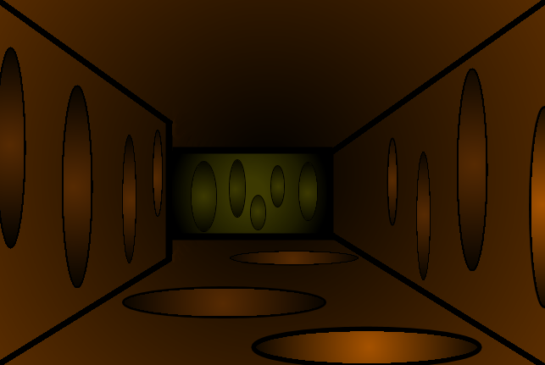

Slide 138
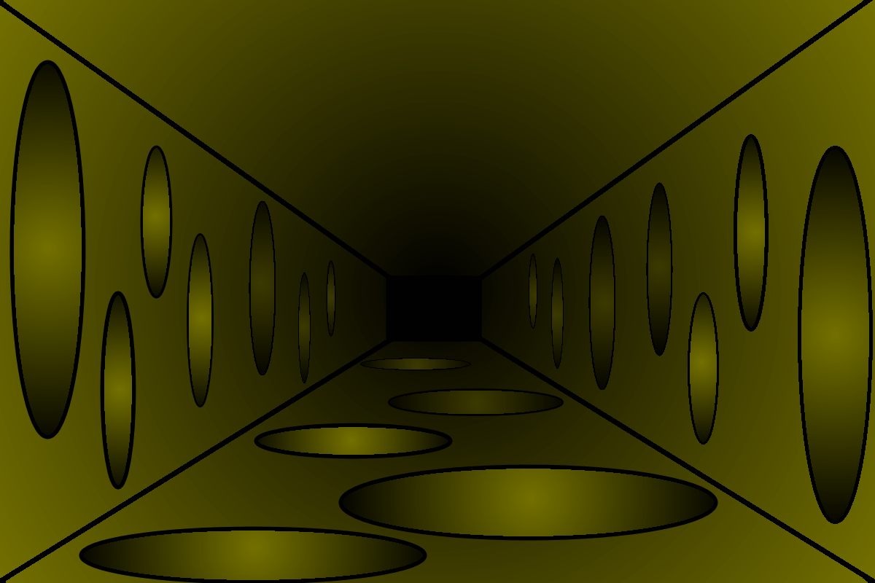

Slide 139
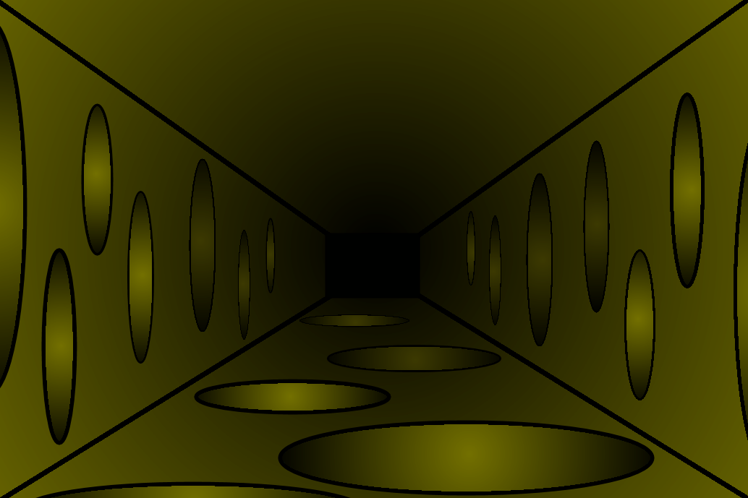

Slide 140
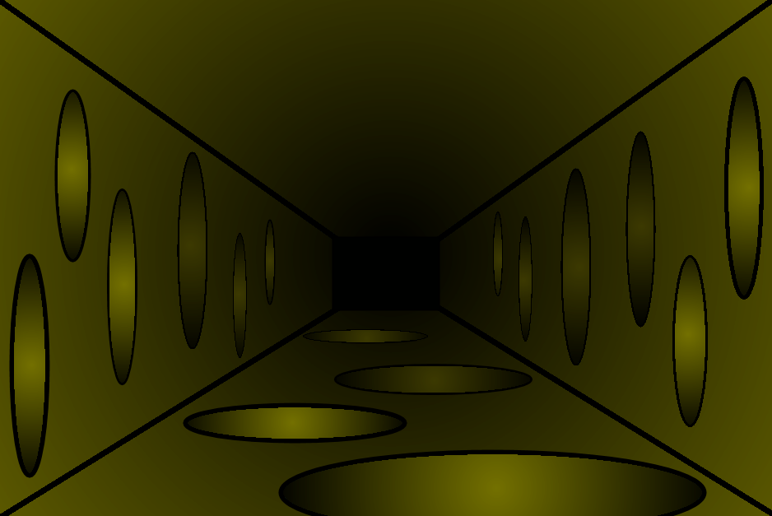

Slide 141
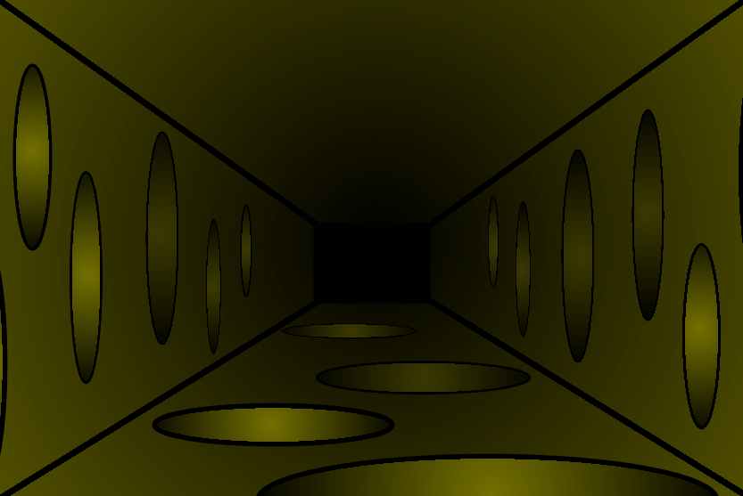

Slide 142
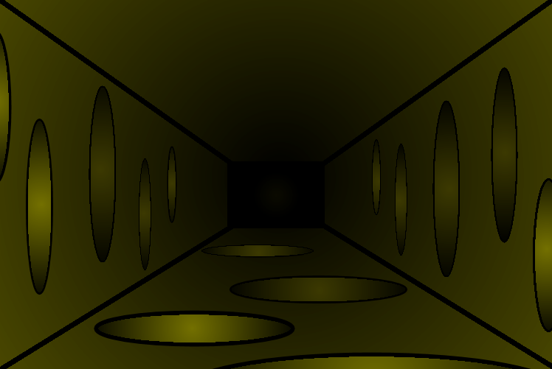

Slide 143
SUPER HERO ACADEMY
BYSTANDER EFFECT
BYSTANDER EFFECT
+ 1 Upstander Power Point
SUPER HERO ACADEMY
– 2 Upstander Power Points

Slide 144
SUPER HERO ACADEMY
BYSTANDER EFFECT

Slide 145
You may have won for now but I will see you again in the future…
or the past.
-The Bystander Effect

