Slide 1
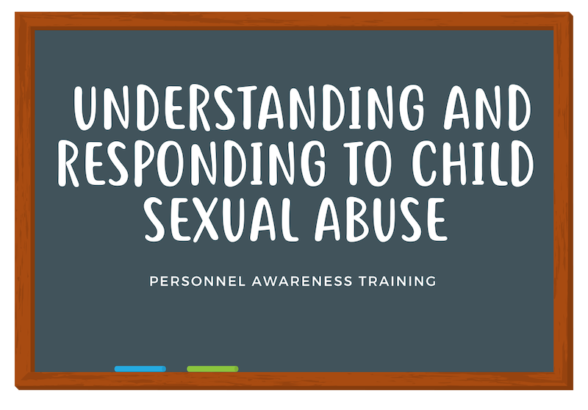
Presented by:
<Name>
<Title>
<Organization>
Notes:
Explain why we use pronouns
Introductions & housekeeping
Introduce trainers, Center educators, then who’s in the room?
Name, position, SAU/agency & one word to describe how you are feeling right now
Engagement: Julia will act as the recorder for the day to keep track of comments, thoughts questions needing follow-up. In addition to a “Parking lot”

Slide 2
Introductions
Pronouns
Notes:
Instead of individual introductions as for the follow groups to raise their hands: School Counselors, Social Workers, Teachers, Administrators, Special Education Staff, Curriculum Coordinators, etc.
After doing this exercise, acknowledge the amount of expertise in the room and explain that we will be drawing on that throughout the day but we also don’t want to assume that everyone is operating with the same amount of knowledge.
Why do we introduce ourselves with our pronouns? Later we’ll be discussing ways you can model and practice protective factors, and we know one way to do this is to support an inclusive school environment.
Normalizing gender inclusivity (including gender expansive identities) by making it standard to say and not assume pronouns, is a low barrier way to do this!
Additionally, taking the time to address pronouns may help mark you as an adult who students can trust, especially if that student uses pronouns that are different than the ones that society “assigned” them.
While Intros are taking place, have one facilitator organize the stickies into similar themes to report back to group.

Slide 3
Group Agreements
Hopes for the Day
Notes:
These are important in your one-hour training– for time sake it might be easier to have a few already jotted down in place for all the see before you start and ask for input. Remind folks that this is a challenging topic and that group agreements exist to keep people safe.
Respect one another
Phones away/silence - Be present
Confidentiality (omit names, omit identifying details, less is better)
use respectful and inclusive language at all times
be aware of body language
commit to practicing giving/receiving feedback
affirm others, even when disagreeing
question your assumptions
ask clarifying questions
Review Prompts from the Beginning of the Day(Review stickies and be clear with what will be covered and what won’t...might be another training or future addition) (S)

Slide 4
Understanding and Responding to Child Sexual Abuse Training Outcomes:
Provide overview of the state law and policy regarding child sexual abuse prevention education and response
Deepen understanding of child sexual abuse
Increase awareness of sexual development, including appropriate and inappropriate behaviors
Increase ability to effectively respond to student disclosures, sexual behaviors, or suspicions of child sexual abuse
Understand school district’s response and referral system to incidences of suspected child sexual abuse
Increase awareness of local resources
Notes:
Review Session outcomes as presented to audience (K)
When you go over this with folks in your one-hour training, it is helpful to remind them that they are not going through the training to become experts, they are there to learn the basics of respond and who to involve if a disclosure happens. It is important to acknowledge that not everyone is comfortable with the content and that is okay.
TOT Engagement: (K)
Ask for questions/thoughts
Be aware of your strengths and areas needing development throughout the training

Slide 5
Overview of Law, Policy, & Resources

Slide 6
Components of the Law
Child sexual abuse response and reporting procedures
Child sexual abuse awareness training and prevention education for school personnel
Age-appropriate child sexual abuse prevention education for students, aligned to the system of learning results and delivered by qualified instructors
School district child sexual abuse response and reporting procedures;
Resources a victim of child sexual abuse or non-offending caregivers of a victim of child sexual abuse may access for services and support
Notes:
This is merely to give folks background and context on the fact that a law does, in fact, exist, and that there are implications on their role in schools. Remind them that they do not need to be an expert on this, just know it exists. This is also something they will be sharing during their one-hour training so folks understand the justification for doing the training.
Explain that the difference between bullet point one and four is that the first one refers to how an individual responds to suspected child sexual abuse – disclosures, the processes for reporting to DHHS/DAs office, etc. and four refers to the policies the schools put into place about systemic responses – how mandated reporter policies work in their schools, who makes the reports, policies re: safety planning, policies about what information they need to collect to be in compliance with school policy.

Slide 7
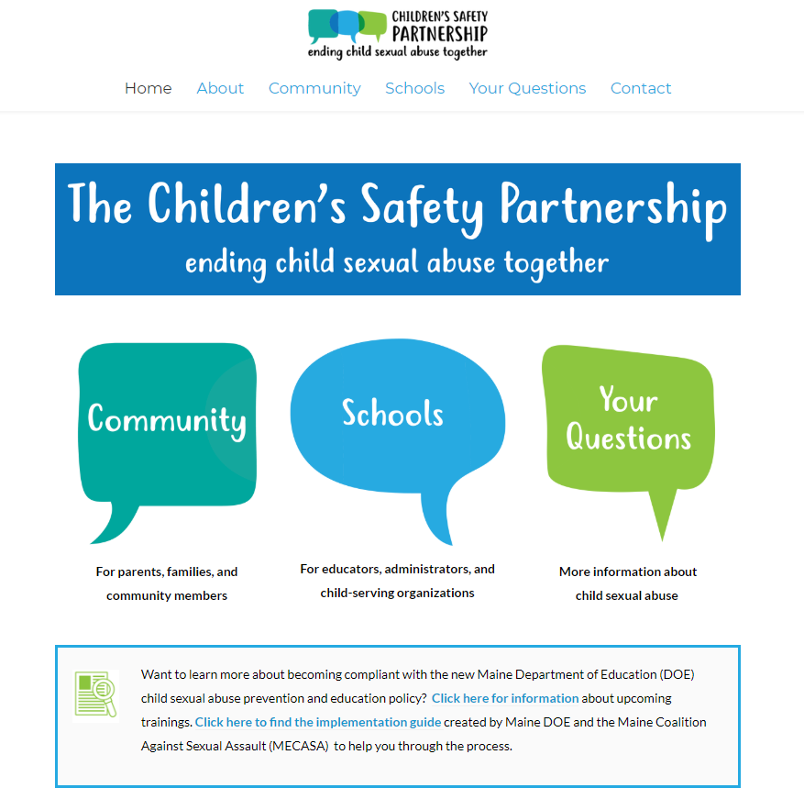
Notes:
The CSP website is available both to you as trainers and to your school personnel. Resources include responding, conversation starters, books that can help talk about the subject, how to create a trauma informed school, and many others. Share this website far and wide. If there is time, it might be helpful to encourage participants to go to the page and bookmark it.

Slide 8
24-Hour Statewide Sexual Assault Support Line
1-800-871-7741
Text/Chat with an Advocate M-F 8am-8pm
mecasa.org
Contact Info for Your Local Center
childrenssafetypartnership.org/contact
Notes:
Knowing that the goal is not for folks to become experts, these are great resources that are available to anyone faced with a disclosure. They are free, private, and available when you need them.

Slide 9
Understanding child sexual abuse

Slide 10
Definition of child sexual abuse
Any sexual activity between an adult and child or adolescent is abusive and illegal. It is an exploitation of power and usually of trust. Sexual activity between two children of significantly unequal power or development can also be abusive. Sexual abuse includes both touching and non-touching acts.
http://www.childrenssafetypartnership.org/your-questions.html
Notes:
This definition is given to again provide context. We share it so folks understand that CSA includes both touching acts (what most people jump to when they think of CSA), and non-touching acts (the more obscure things that are pervasive but not as obvious).
Deliberate contact with a child or teen’s genitals, buttocks or chest/breasts;
Penetration of the child or teen’s mouth, anus, or vagina with an object or body part;
Making a child or teen touch another person’s anus, penis, or vagina; and,
Coercing a child or teen to touch him/herself, the offender or another child.
Non-touching behavior examples:
Exposing oneself to a child or teen;
Viewing and violating the private behaviors of a child or teen;
Taking sexually explicit or provocative photographs of a child or teen;
Showing pornography to a child or teen; and, Communicating with a child or teen about sexually explicit fantasies or experiences (in person, by phone, via email or Internet, etc.).

Slide 11
CSA Statistics
The vast majority of sexual abuse is never reported – 38% of children disclose
Research shows that children rarely make up accusations of sexual abuse – only about 4-8% are false
Notes:
Review stats . Child sexual abuse is far more prevalent than most people realize. It is likely the most prevalent health problem children face with the most serious array of consequences. About one in 10 children will be sexually abused before their 18th birthday.* Nearly 70% of all reported sexual assaults (including assaults on adults) occur to children aged 17 and under. 9, 10. IN Maine it is just over 50 percent. Accusations that are false are 4 to 8 percent. Whileconviction rates are high, arrest are only made in 29 percent of child sexual abuse cases, and are 32 percent of these are older children, not adults. For children under 6 only 19 percent of sexual abuse incidents end in arrest. Child protective agencies investigate about 55 percent of reports. The rest are screened out for lack of information, of those investigated, only a portion meet criteria.
30 percent of children are abused by family members, 40 percent by older children.

Slide 12
CSA Statistics
One if five girls and one in 20 boys experience child sexual abuse
Half of all calls to Maine’s sexual assault crisis and support line are from or about people under 18.
Notes:
Review stats . Child sexual abuse is far more prevalent than most people realize. It is likely the most prevalent health problem children face with the most serious array of consequences. About one in 10 children will be sexually abused before their 18th birthday.* Nearly 70% of all reported sexual assaults (including assaults on adults) occur to children aged 17 and under. 9, 10. IN Maine it is just over 50 percent. Accusations that are false are 4 to 8 percent. Whileconviction rates are high, arrest are only made in 29 percent of child sexual abuse cases, and are 32 percent of these are older children, not adults. For children under 6 only 19 percent of sexual abuse incidents end in arrest. Child protective agencies investigate about 55 percent of reports. The rest are screened out for lack of information, of those investigated, only a portion meet criteria.
30 percent of children are abused by family members, 40 percent by older children.

Slide 13
CSA Statistics
School personnel identify 52% of all identified child abuse cases, more than any other profession or organizational type, including child protective services agencies and the police.
Notes:
This is a HUGE stat to share. There are a lot of folks who wonder why they have to take the training – particularly volunteers, food services, transportation, custodial arts, etc. who might not have the traditional day-to-day relationships with students as classroom teachers and support professionals. This statistic is why. You never know who a child might feel most comfortable to disclose to.

Slide 14
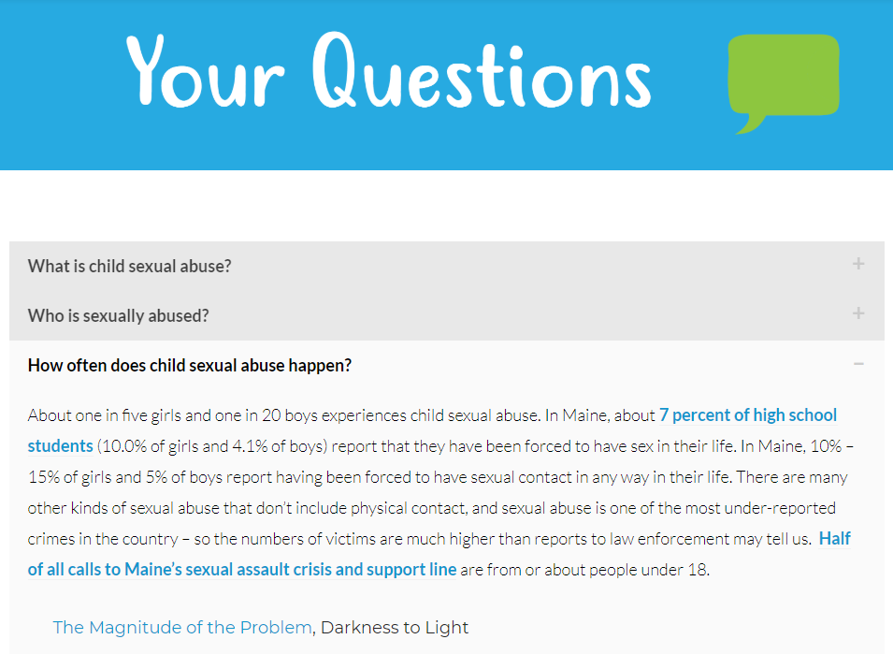
Notes:
Note that the “Your questions” tab on the CSP website can provide more information about statistics that trainers can pull if they are looking for different factual ways to engage with their group.

Slide 15
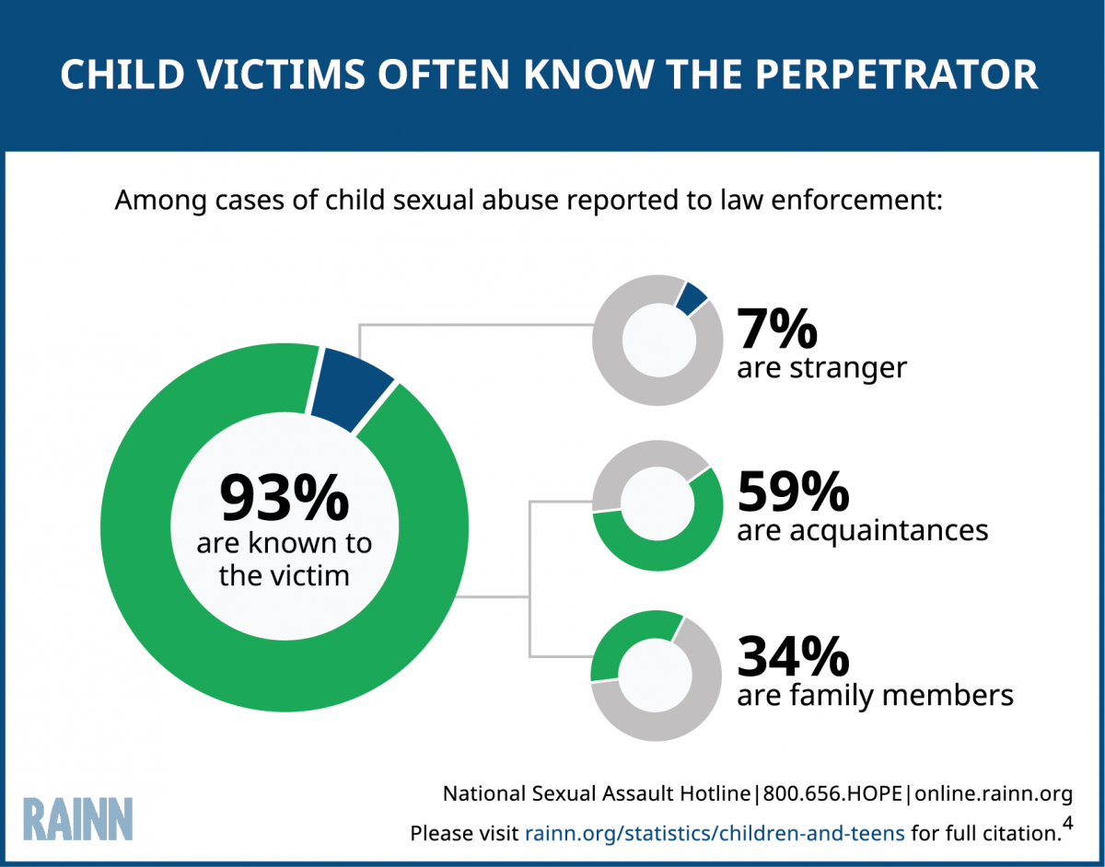
Who sexually abuses children?
???
Notes:
Engagement: With a partner, what does this slide say to you? an audience? Why are statistics different?
This is also a good slide to emphasize. Stranger danger is the assumption but statistics tell us otherwise.

Slide 16
Understanding Sexual Development
Notes:
Understanding Sexual Development (10 minutes)

Slide 17
Educate ourselves about how to distinguish between:
developmentally expected sexual behaviors and
potentially problematic sexual behaviors
Notes:
Children’s behaviors typically fit into one of two categories: developmentally expected and potentially problematic. However, just because a behavior is “typical” or “developmentally expected” does not mean it is acceptable or appropriate in every context or in every family. Families, schools, or early education programs can make decisions about what behaviors are appropriate within each of those contexts. What this discussion does is provide a child development framework for understanding children’s sexual behaviors.
Sometimes developmentally expected behaviors can still feel icky, but don’t make decisions based on that feeling, instead make decisions based on knowledge.
We talk about this to support kids through all facets of their development, CSA prevention and response. Remember just because something seems common, doesn’t mean nothing is happening and just because something is uncommon doesn’t mean it is happening.
When in doubt, report it.

Slide 18
Preschool Age (0-5 years)
Common:
Thumb sucking, stroking/holding of genitals (masturbation)
Wanting to touch other children’s genitals
Asking about or wanting to touch breasts, bottoms, genitals of familiar adults
Exploratory play (i.e. Doctor/nurse, “show me yours, I’ll show you mine”)
Enjoyment of being nude
Interest in body parts and functions
Uncommon:
Having knowledge of specific sexual acts or explicit sexual language;
Engaging in adult-like sexual contact with other children
Using objects in a sexual manner
Notes:
While having a list can be helpful, there is often a thin line between developmentally expected behavior and potentially problematic behaviors. If you’re unsure, report behavior. Talking more openly about body parts, and gender helps children feel more empowered and in charge of their own bodies.
Questions about the list? Anything that needs to be added?
Sources:
The Society of Obstetricians and Gynaecologists of Canada: www.sexualityandu.ca
Advocates for Youth: www.advocatesforyouth.org
https://www.stopitnow.org/ohc-content/tip-sheet-23

Slide 19
School-Age (5-9 years)
Common:
Masturbation to self-soothe
Increased curiosity in adult sexuality (questions about babies, gender differences)
Increased curiosity about other children’s genitals
Telling stories
Uncommon:
Adult-like sexual interactions;
Having knowledge of non-reproductive based sexual acts;
Acting out in sexual ways in a public place
Engaging in sexually explicit behavior using technology
Using objects in a sexual manner
Notes:
While having a list can be helpful, there is often a thin line between developmentally expected behavior and potentially problematic behaviors. If you’re unsure, report behavior. Talking more openly about body parts, and gender helps children feel more empowered and in charge of their own bodies.
Questions about the list? Anything that needs to be added?
Sources:
The Society of Obstetricians and Gynaecologists of Canada: www.sexualityandu.ca
Advocates for Youth: www.advocatesforyouth.org

Slide 20
School-Age (9-12 years)
Common:
Will want to learn more and have questions about:
Relationships and sexual behaviors
Sexual words, sexual acts and personal values, particularly with peers
Menstruation and sperm production begin
Self-stimulation/masturbation in private is expected to continue;
Increased curiosity and experimentation with sexual behaviors and romantic relationships
Uncommon:
Adult-like sexual behavior;
Acting out in sexual ways in a public place
Notes:
While having a list can be helpful, there is often a thin line between developmentally expected behavior and potentially problematic behaviors. If you’re unsure, report behavior. Talking more openly about body parts, and gender helps children feel more empowered and in charge of their own bodies.
Questions about the list? Anything that needs to be added?
Sources:
The Society of Obstetricians and Gynaecologists of Canada: www.sexualityandu.ca
Advocates for Youth: www.advocatesforyouth.org

Slide 21
Adolescence (13-16 years)
Common:
Will want to learn more and have questions about:
Decision making
Social relationships and sexual concerns
Personal values and consequences of sexual behavior
Self-stimulation/masturbation in private is expected to continue
Menstruation and sperm production begin
Sexual experimentation between adolescents of the similar age
Voyeuristic behaviors within peer groups
First sexual intercourse occurs for one third of teens
Uncommon:
Masturbation in a public place
Sexual interest/relationships beyond similar aged peers
Notes:
While having a list can be helpful, there is often a thin line between developmentally expected behavior and potentially problematic behaviors. If you’re unsure, report behavior. Talking more openly about body parts, and gender helps children feel more empowered and in charge of their own bodies.
Questions about the list? Anything that needs to be added?
Sources:
The Society of Obstetricians and Gynaecologists of Canada: www.sexualityandu.ca
Advocates for Youth: www.advocatesforyouth.org

Slide 22
In younger children, signs/behaviors of those who may be experiencing CSA include:
Knowing about sex acts that are out of the ordinary or unexpected for their age
Saying, drawing, or doing anything sexual toward people, animals, or things
Masturbating until they are hurt, many times a day, or using items or thrusting
Problems with sleep, self-harm, fear of certain adults, or not wanting to be alone
Notes:
While having a list can be helpful, there is often a thin line between developmentally expected behavior and potentially problematic behaviors. If you’re unsure, report behavior.

Slide 23
In older children, signs/behaviors of those who may be experiencing CSA include:
Early sexual activities with peers
Knowledge of and engaging in sexual activity
Problems with eating
Committing unlawful, dangerous, or risky acts
Running away
Substance use
Self-destructive activities
Notes:
While having a list can be helpful, there is often a thin line between developmentally expected behavior and potentially problematic behaviors. If you’re unsure, report behavior.
It is important to remember that just because you see a student exhibiting these behaviors, it doesn’t’ always mean they are experiencing CSA. These signs and behaviors can be result of various forms of trauma.
Questions about the list? Anything that needs to be added?

Slide 24
Responding to Sexual Behaviors
Notes:
Responding to Sexual Behaviors (10 minutes)
Just a reminder, this is hard. Even for those who have been receiving disclosures for years find this hard. You are never in this alone – know your school’s protocol and the resources you have available to you.

Slide 25
Model for Responding to Children’s Sexual Behaviors
communication
empathy
accountability
These are protective factors for healthy development.
Notes:
Here are some words to use when responding to a behavior or interaction that model for the child a way of communicating that is clear and helps children learn empathy and accountability for their behavior. Remember, remain calm and continue to assess the situation. Depending on the behavior, calmly redirect when you can.
1. MODEL COMMUNICATION: Be clear and direct. Label the behavior for the child
2. FOSTER EMPATHY: Respond from a personal place and label your feeling (or another’s)
3. PROMOTE ACCOUNTABILITY: If needed, ask clarifying open ended questions. Then, set an appropriate limit, rule or expectation to promote the child’s responsibility for their behavior

Slide 26
Communication
Stay calm
Clearly address the behavior
Avoid judgement-based questions
“I noticed you…”
“Can you tell me a little more about…”
Notes:
Here are some words to use when responding to a behavior or interaction that model for the child a way of communicating that is clear and helps children learn empathy and accountability for their behavior. Remember, remain calm and continue to assess the situation. Depending on the behavior, calmly redirect when you can.
1. MODEL COMMUNICATION: Be clear and direct. Label the behavior for the child
2. FOSTER EMPATHY: Respond from a personal place and label your feeling (or another’s)
3. PROMOTE ACCOUNTABILITY: If needed, ask clarifying open ended questions. Then, set an appropriate limit, rule or expectation to promote the child’s responsibility for their behavior
Healthy communication • Talking openly and honestly sends the message that their bodies are special and their own, nothing to be ashamed or embarrassed about. • This knowledge gives children the correct language for understanding their bodies, asking questions and telling about any behavior that could lead to sexual abuse

Slide 27
Empathy
Avoid shaming
Foster empathy for others
“Did you see them frowning? They didn’t look like they were enjoying that…”
“Their body belongs to them. That’s why it’s important to ask before we touch someone…”
Notes:
Here are some words to use when responding to a behavior or interaction that model for the child a way of communicating that is clear and helps children learn empathy and accountability for their behavior. Remember, remain calm and continue to assess the situation. Depending on the behavior, calmly redirect when you can.
1. MODEL COMMUNICATION: Be clear and direct. Label the behavior for the child
2. FOSTER EMPATHY: Respond from a personal place and label your feeling (or another’s)
3. PROMOTE ACCOUNTABILITY: If needed, ask clarifying open ended questions. Then, set an appropriate limit, rule or expectation to promote the child’s responsibility for their behavior
Healthy communication • Talking openly and honestly sends the message that their bodies are special and their own, nothing to be ashamed or embarrassed about. • This knowledge gives children the correct language for understanding their bodies, asking questions and telling about any behavior that could lead to sexual abuse

Slide 28
Accountability
Help them change the behavior
“Next time if you want a touch, ask for a hug or high five or fist bump.”
“It’s okay to be curious about those things. Let’s see if I can find you a book to read at home about it.”
Notes:
Here are some words to use when responding to a behavior or interaction that model for the child a way of communicating that is clear and helps children learn empathy and accountability for their behavior. Remember, remain calm and continue to assess the situation. Depending on the behavior, calmly redirect when you can.
1. MODEL COMMUNICATION: Be clear and direct. Label the behavior for the child
2. FOSTER EMPATHY: Respond from a personal place and label your feeling (or another’s)
3. PROMOTE ACCOUNTABILITY: If needed, ask clarifying open ended questions. Then, set an appropriate limit, rule or expectation to promote the child’s responsibility for their behavior
Healthy communication • Talking openly and honestly sends the message that their bodies are special and their own, nothing to be ashamed or embarrassed about. • This knowledge gives children the correct language for understanding their bodies, asking questions and telling about any behavior that could lead to sexual abuse

Slide 29
Tips for Responding to Sexual Behaviors (Heard about or Observed)
Stay calm
Don’t ignore the behavior
Avoid shaming and victim blaming language
Avoid probing questions
Redirect when you can (child - child)
Notes:
We specifically focus on sharing how to respond to disclosure, and it is a facet of the law, because statistics tells us that school personnel identify 52% of CSA cases – more than any other profession including CPS and police. Knowing the signs and how to respond can make a huge difference in a child’s life!
http://www.d2l.org/wp-content/uploads/2017/01/all_statistics_20150619.pdf
Visit site: http://www.childrenssafetypartnership.org/supporting-students.html
A key piece to remember when a child tells you they are a victim of CSA is that what has happened/is happening to them is NOT their fault. Our role in responding to disclosures is to believe the child and work to get them the support and safety they need. Asking questions or saying things like “Well what were you doing when that happened” or “I know that person, they are nice and would NEVER do that” put the blame on the child which is not okay.

Slide 30
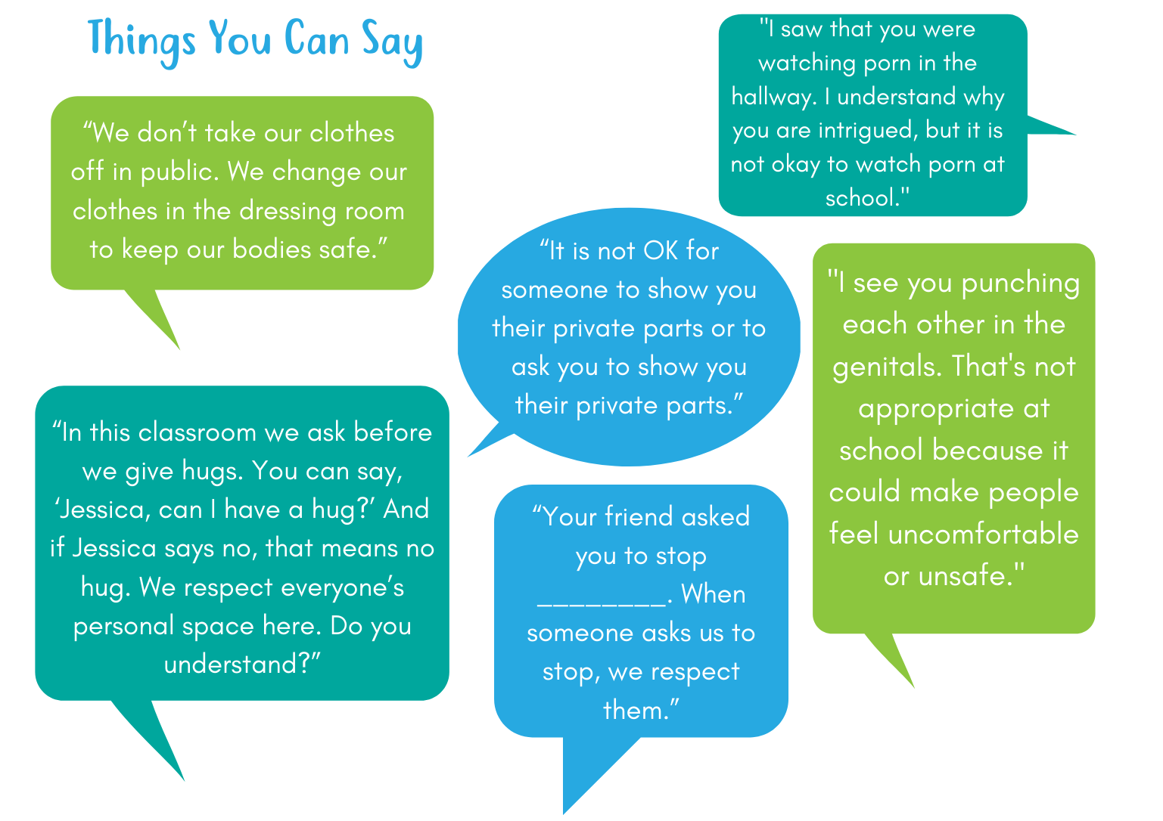
Notes:
I see you trying to kiss your classmate on the cheek
Your classmate pulled away and was visibly uncomfortable
At school, we do not kiss each other.
What are some things you can say if you see this happening with older children?

Slide 31
A Child Just Disclosed –
Some Things to Consider Saying and Doing
Thank you for telling me.
You are very brave for telling me.
You didn’t do anything wrong.
I’m sorry that happened to you.
I can’t keep this a secret, because it is about your safety. I am going to talk to….
Are you a mandated reporter? If yes, follow the protocol to make a report.
Your job is to do what you can to keep the child safe.
Remember to find support for yourself.
Notes:
It’s important to emphasize that responding the sexual behaviors and responding to disclosures are two different things that can have vastly different emotional implications.
We specifically focus on sharing how to respond to disclosure, and it is a facet of the law, because statistics tells us that school personnel identify 52% of CSA cases – more than any other profession including CPS and police. Knowing the signs and how to respond can make a huge difference in a child’s life!
http://www.d2l.org/wp-content/uploads/2017/01/all_statistics_20150619.pdf
Visit site: http://www.childrenssafetypartnership.org/supporting-students.html

Slide 32
What if you suspect an adult of CSA?
Inappropriate behaviors one might see
How to refer vs intervene
Resources on partnership page
Know your school/districts
response and referral system!

Slide 33
Red Flags
Appears “too good to be true”
Spends noticeable amount of time with children, rather than those their own age
Singles out a child and gives them notable age-inappropriate attention
Repeatedly ignores social, emotional, and/or physical boundaries
Shares inappropriate private and/or personal information with a child
Points out or shares sexual images or tells inappropriate stories or jokes in front of children

Slide 34
Commercial Sexual Exploitation of Children (CSEC)
A form of human trafficking, CSEC is a range of crimes where someone is profiting financially off the sexual abuse of a child
Often kids don’t share when this is happening to them. However, adults might notice the following things:
frequent unexplained absences from school
trips to cities without social connections there
sudden appearance of material goods that they normally could not afford
"partying" and socializing with older people
signs of being in a relationship with someone abusive and controlling (monitoring movement, fearful, detaching from support networks)
Notes:
Commercial refers to money, financial gain or other financial incentive.
If you are a mandated reporter you are legally required to report any suspicion that someone is experiencing CSEC since CSEC is a form of child abuse. When you call, be specific about what you have noticed that makes you concerned and also about what you think might be happening, for example, "I think this child might be being trafficked for sex".
It is estimated that between 300-400 people experience sex trafficking or exploitation each year in Maine. Not all of them are under 18, but many people report that the exploitation started when they were younger than 18. We still don't have enough data in Maine to project the prevalence of CSEC specifically - but we definitely know it happens here. If you are not a mandated reporter, you can still call the police or DHHS to report suspected abuse. If you'd rather make an anonymous tip, you can also call the National Human Trafficking Hotline at 1-888-373-7888.

Slide 35
Response and Referral System
Notes:
If you know your district’s policy, be sure to go over it as you prep for training. It will help you be able to answer more specific questions about what this system means for your school. Just a reminder, all districts should have a policy in place at this point. If yours doesn’t advocate to your principle/superintendent!

Slide 36
Who is required to make reports?
All school personnel - school faculty, staff, coaches and activities advisors – as well as school volunteers.
What gets reported?
Any time abuse is known or suspected.
This includes threats to a child’s health or welfare by physical, mental or emotional injury or impairment, sexual abuse or exploitation, deprivation of essential needs or lack of protection from these.
Notes:
Basically explain that anyone who is involved with any facet of school life (with the exception of one-off folks like outside maintenance and repair people) are included in mandated reporting requirements.
Again, stress “When in doubt, report it”. Even if you are not sure, you do not know if DHHS is already building a case on this child and just need one more piece of evidence to move it forward. Just do it.

Slide 37
How do I make a report?
Mandated reporters in Maine are required to report known or suspected abuse directly to the Maine DHHS or a District Attorney.
Check your school’s policies and procedures.
If individuals don’t report directly, but instead report to a school’s designated reporter, they must confirm in writing that a report was made on their behalf.
Notes:
By all means, tweak this slide for your school if your policy differs from what is written – feel free to take out the part about the designated reporter if that does not apply to your school. Again, talk about your school’s policy throughout this section and if you can get your hands on a copy that can be shared with folks, that is even better.

Slide 38
How soon do I make the report?
Reports must be made immediately and followed up in writing within 24 hours on request.
Every report is documented, however not every report is assigned to a caseworker for investigation.
Notes:
Again, even if you are not sure, make the report.

Slide 39
Considerations
Written documentation should be strictly limited, and only include required information, rather than personal assessments or conclusions.
Individuals should discuss their concerns with as few other people as possible.
Children’s Advocacy Centers exist to support children through the investigation process. If you’re reporting, it never hurts to mention this to the DHHS intake worker.
Notes:
Please note that while it says to discuss concerns with as few other people as possible, sometimes it can be helpful to check in with someone who has additional knowledge. If that person is you (as the trainer) tell folks that. Sometimes all folks need to feel comfortable responding to something is to know they are not in it by themselves.

Slide 40
Create a safe space for the student whenever possible.
Remind the child that you are a trusted adult.
Check in with your district’s policy if safety is a concern.
Take care of yourself – find support in whatever way works best for you.
Notes:
Remember that whatever happened to this child has completely changed their lives. It is important that just because a report is made, we don’t just move on and act as if all is normal. Students who have experience sexual abuse may need additional support or accommodations as they go through any processes that come out of the reporting process.

Slide 41
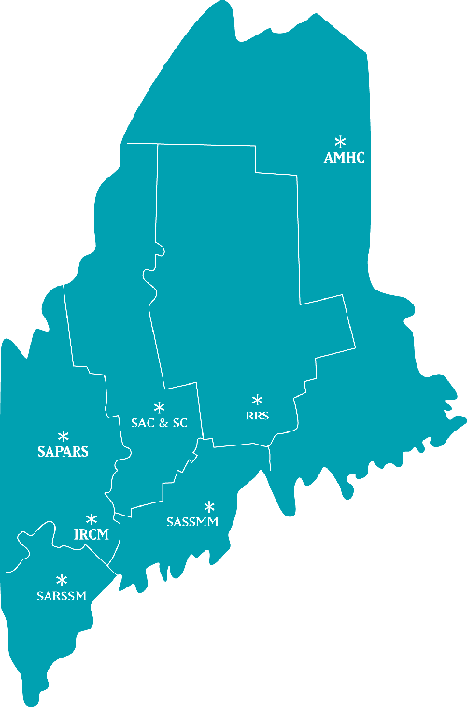
Know Your Resources
Center Name
Center Address
Center Address
Catchment area
Email address
Phone number
Who is your local sexual assault support center?
Where/what is your district’s policy?
Who is your district’s Title IX coordinator?
www.childrenssafetypartnership.org/contact.html
Notes:
Know this information prior to sharing this slide – be able to tell folks who your SA provider is and provide contact info if needed.
Know whether your school has a policy or not
Know who your district’s Title IX coordinator is. Feel free to ask if folks know what Title IX is and if they don’t provide this for context: https://www.knowyourix.org/college-resources/title-ix/
Also note that Title IX prohibits sex discrimination in educational institutions that receive federal funding (most schools)/
All of Maine’s sexual assault support centers provide:
A 24-hour statewide sexual assault crisis and support line
Support groups
Crisis intervention and information
Support and advocacy for victim/survivors of sexual assault and their families
Advocacy for victim/survivors who choose to seek medical attention, report to the police, and/or go through the criminal justice system no matter when the violence was perpetrated
Referrals to mental health professionals and other community services
School, community and professional education programs for all ages on topics such as sexual harassment, sexual assault, peer education programs, and prevention

Slide 42
Questions?

Slide 43
Thank You!

