Slide 1
Ensuring Meaningful Access for Survivors with Limited English Proficiency
(Agency logo here)

Slide 2
(Part 1) Language Access, the Law and Why We Care Learning Objectives -- Participants will:
Demonstrate an understanding of the ethical rationale for providing meaningful access to services for survivors.
Advocate for meaningful access as an essential component of services for survivors with limited English proficiency.
Explain requirements of Title VI of Civil Rights Act of 1964 and related federal guidance.

Slide 3
Why Provide Meaningful Language Access?
1. It’s the right thing to do.
As organizations dedicated to ending and preventing domestic and sexual violence we all work toward ensuring safety, healing and justice for those harmed by violence.
If we invest in being proactive, we can ensure that all individuals with LEP have meaningful access to critical services.
Notes:
Safety, healing an justice are unattainable unless we practice cultural and linguistic competency consistently and improve language access at organizational and individual levels.
Domestic violence programs that have not developed a language access plan often find themselves operating reactively­ when it comes to providing language access. That is, by responding to the needs of one particular individual with LEP at a time and seeking ways to include her participation in the programs when the situation arises.
Advocates have found resourceful and creative ways to communicate with individuals with LEP, but relying on a patchwork of ad-hoc communication methods is guaranteed at some point to make advocates feel ineffective or frustrated and survivors feel isolated, lonely and confused.
It is important to recognize that the lack of a proactive plan for meeting the language needs of individuals with LEP can undermine meaningful access to those services and compromise their safety and options.

Slide 4
Why Provide Meaningful Language Access?
2. The rise in immigration and the shift in U.S. settlement patterns:
Approximately 25.2 million individuals with limited English proficiency (LEP) currently live in the U.S.
The number of individuals with LEP living in the United States has increased by approximately 80 percent between 1990 and 2010¹.
The languages spoken by this population with LEP are more diverse than ever.
¹Limited English Proficient Individuals in the United States: Number, Share, Growth, and Linguistic Diversity, Migration Policy Institute, December 2011.
Notes:
NOTE TO COALITION TRAINERS: In training member programs, use whatever state, county, or local data is available

Slide 5
Who are Individuals with LEP?
Individuals with LEP are those individuals who do not speak English as their primary language and have a limited ability to read, write, speak or understand English.
Deaf (upper case ‘D’) refers to an identity with its own culture, language, and diverse communities
‘deaf’ refers to a physical condition/ impairment
Deaf and hard of hearing often understood as a disability issue, but is also a language issue.

Slide 6
Why Provide Meaningful Language Access?
3. Language access improves services and enhances outcomes.
Research shows that domestic violence survivors with LEP were more likely to seek out services if those services were provided in their language.
Language access clearly enhances safety if you consider that without it, the survivor cannot interact fluently with an advocate, other service providers and systems.
Research in the domestic violence and sexual assault fields shows that survivors appreciate and feel more supported when language access services are provided.
Notes:
SHOW CASA/NLN SURVIVOR VIDEO AFTER THIS SLIDE
Many people who exert power and control use their partner’s inability to speak English as a tool for abuse. Survivors with LEP have less access to services and can face systemic barriers when dealing with the legal, medical and other systems. Providing meaningful language access makes this tactic of coercive control less effective.
Reference DV Hotline Study here:
DV Hotline Survey:
Six-week survey in August of 2012
1,305 Latina callers participated in the survey
583 (45%) said they were foreign-born
39% of foreign-born Latinas said they were afraid of calling the police or going to court for help as a result of the general immigration situation
31% of Spanish speakers said they encountered language barriers in trying to seek services (1 in 4 callers had never reached out for services before calling the Hotline)

Slide 7
Why Provide Meaningful Language Access?
4. It’s a legal requirement:
Any organization that receives federal financial assistance—either directly or indirectly—is required to comply with Title VI of the Civil Right Act of 1964 (Title VI) and the Omnibus Crime Control and Safe Streets Act of 1968 (Safe Streets Act).
If an organization receives any federal funds then all aspects of that organization are obligated to take reasonable steps to ensure that individuals with LEP have meaningful access to the benefits and services provided by that organization.
Notes:
Most domestic violence and sexual assault programs in the U.S. receive some form of federal funding—whether through grants, contracts or subcontracts from different sources, including the following:
the Family Violence Prevention Services Act (FVPSA);
the Victims of Crime Act (VOCA);
the Services, Training, Officers and Prosecutors (STOP) grants program, or another program of the Violence Against Women Act (VAWA).
The Department of Housing and Urban Development (HUD) also provides federal funding to domestic violence programs. Often times this federal money is distributed to the States who then pass it through to domestic violence or sexual assault programs.
Both Title VI and the Safe Streets Act prohibit recipients of federal funding from discriminating based on race, color, or national origin.
In Lau v. Nichols (1973), the Supreme Court held “failing to take reasonable steps to ensure MEANINGFUL access for LEP persons is national origin discrimination under Title VI.” The Supreme Court has defined one type of national origin discrimination as discrimination that is based on a person’s inability to speak, read, write or understand English. See Lau v. Nichols, 414 U.S. 563 (1974).

Slide 8
Language Access Obligations under Title VI of the Civil Rights Act. Are you in compliance?
Notes:
(Note: This is a separate set of slides available to trainers on Title VI and related federal guidance. See TOT materials for the full version.)

Slide 9
(Part 2) Language Access Planning Learning Objectives -- Participants will:
Describe the basic steps for creating a language access plan.
Develop comprehensive and effective Language Access Plans.
Identify issues and challenges around creating language accessible programs, and learn strategies for addressing them.

Slide 10
Providing Meaningful Access
Means any individual
with LEP is not denied the
opportunity to access and
obtain the services and
supports necessary for
their safety and well
being as a result of
language barriers.

Slide 11
Taking Reasonable Steps
Refers to being committed and prepared to
provide critical services that support the
well-being and safety of survivors by:
having a proactive plan in place to address the needs of survivors with LEP.
what is reasonable is dependent on a demographic assessment of the organization’s service area and the most commonly encountered languages.
Notes:
The bar of reasonableness is higher for more commonly encountered languages.
2. Nonetheless, organizations that receive federal financial assistance cannot discriminate against any individual with LEP, pursuant to Title VI of the Civil Rights Act, and must take appropriate steps to provide language access to any individual with LEP who seeks the services of the organization .

Slide 12
4 Factor Analysis for Meaningful Access
The number or proportion of LEP individuals served or encountered in an LEP population
Frequency of interaction
Nature and importance of the program, activity, or service provided by the program
Resources available to the recipient
Notes:
Demonstrate how to use and when to use - the balancing test will help determine strategies of how to communicate population.

Slide 13
Providing Meaningful Language Access
Usually involves multiple strategies, including:
hiring bilingual and bicultural advocates
offering translated written materials
using a telephone interpreter service
using in-person interpreters
establishing co-advocacy arrangements with community-based programs
establishing a language bank
Notes:
The strategies you choose will depend on the number of survivors with LEP and the number of languages spoken in your community, as well as the
available resources in your community. Bottom line, all survivors you work with must have meaningful access to services regardless of the language they speak.

Slide 14
Language Access Plan
A Language Access Plan is a strategy to assess, identify, and manage a system to ensure that limited English proficient (LEP) individuals are able to access services.
Notes:
- Not just most common languages, but be prepared to provide access to infrequent languages spoken by victims seeking help.

Slide 15
Developing an effective Language Access Plan
Language Access Plan
Identification and assessment of LEP communities
Collaboration with LEP communities and other stakeholders
Description of timeframes, objectives and benchmarks
Identification of funding and procurement strategies
Staff training on policies and procedures
Outreach to notify survivors of language assistance services
Identification of persons who will implement the plan
Monitoring and updating of policies, plan and procedures
Notes:
Partner with other organizations to provide language access. Organizations often collaborate with culturally specific organizations to provide interpretation. However many culturally specific organizations feel the burden of cost, hours, and labor without adequate support or resources. Build resources and collaborate so both organizations mutually benefit.

Slide 16
Developing a Language Access Plan
Who is in charge?
Who are you serving?
What will be done?
Who pays?
Providing notice
Training staff
Monitoring and updating policies and procedures
Collaborating with your supporting communities and LEP communities

Slide 17
Engaging Staff and Stakeholders and Creating Buy-in
Step 1.
Identify 4-6 staff members to be actively engaged in the process of developing the organizational LEP plan.
How will you involve survivors with LEP? How will you involve community partners who have information and ideas that may help you?
Notes:
Create ownership in programs. Convene key stakeholders who will drive creation and implementation of a meaningful language access plan. When people are in the ‘driver’s seat’, they are more likely to take responsibility for the successful implementation of plans.

Slide 18
Creating Buy-in: Work Group Discussion
What are the benefits to increasing language access?
How important are the services we provide to the lives of people who seek our services ?
What are the costs of not having language access?
What are our concerns about increasing language access?
How can having a language access plan help alleviate those concerns?
How is developing a language access plan consistent with the mission and vision of the organization ?

Slide 19
LEP Plan Self-Assessment
Who is your LEP population?
How does the LEP population come into contact with your organization?
How is your organization serving LEP populations?
What trainings for staff do you have in place?
How do you reach your LEP populations?
What are your policies and procedures?

Slide 20
Which Languages are Spoken in Your Community?
Step 2.
Identify the number or proportion of individuals with LEP eligible to be served or likely to be encountered by your program.
Who are the people who live in the community you serve?
Notes:
Speaks to Identifying Organizational Needs

Slide 21
Which Languages are Spoken in Your Community?
Local government, school districts, local colleges and universities are resources for obtaining data.
For information on local immigrant populations, conduct a Google search using key terms such as: English limited proficiency, immigrant and refugee populations in your town or city.
3. Review US Census data for current immigrant populations, also consider predicted populations.
http://www.census.gov/2010census/
Review US Census data on the use of languages in the US.
http://www.census.gov/hhes/socdemo/language/ and in your state,
http://www.census.gov/population/www/cen2000/briefs/phc-t20/tables/tab01.pdf

Slide 22
Which Languages are Spoken by Those Who Come to Your Program?
Step 3.
Identify the top 3 to 5 languages (other than English) spoken by participants who come to your program.
What do culturally specific organizations in your community know about which survivors access your services, which don’t, and why?

Slide 23
Which Languages are Spoken by Those Who Come to Your Program?
Review your program’s demographic data to see which survivors with LEP have contacted your organization and with what frequency.
Pull numbers from all aspects of your program – hotline, shelter, support groups, outreach materials, etc.
Consider that survivors with LEP may not be aware of your program or believe that it may not be accessible to them.

Slide 24
What is your current capacity?
Step 4.
Assess how you are
currently serving
speakers of the languages
identified in Steps Two
and Three.
Bicultural/bilingual staff
Co-advocacy agreement
In-person interpreters
Language line
Notes:
Start from what’s already in place. Most organizations have policy or philosophy that informs their approach to serving survivors with limited English proficiency. Organizations should build on what they already have in place.
For example, if a program already has a bilingual advocate, then explore how the advocate can be better supported in her/his role. If a program uses a translation/interpretation service, confirm whether sufficient funds are available to utilize that service

Slide 25
How Are You Currently Providing Language Access?
Identify your organization’s strengths and weaknesses in providing meaningful access through language services.
Engage the entire staff in this process.
Conduct a confidential survey to ask staff about their own language skills as well as which languages they need more assistance accessing.
Use the results to drive policy, planning, hiring and training.

Slide 26
Reflection: Language Access Plans
Who participated in the development of your organizational LAP? Where in the plan do the self-identified needs of survivors show up?
In your analysis, which language groups were identified as needing to be prioritized in your organizational planning? What specific steps in the plan resulted from that analysis?
Of current efforts to provide language access, where and how has your organization been successful? How can you build on those successes?
Notes:
Possible small group discussion questions – edit as needed

Slide 27
Developing a Plan for Improvement
Step 5.
Since the services you provide are critical to a survivor’s physical and emotional safety, you must take reasonable steps to ensure that survivors with limited English proficiency have meaningful access to your services.
Notes:
Determine ‘reasonable steps’. Determining reasonable steps to provide meaningful access is unique to each organization and the communities they serve.
Reasonable steps can range from having “I Speak” cards printed and available to hiring and training bilingual advocates.

Slide 28
Developing a Plan for Improvement
Sexual and domestic violence programs
are often critical for survivor safety and,
therefore, have a greater obligation to
provide language services.
Reasonable steps may include:
Hiring bicultural/bilingual advocates
Hiring interpreters
Contracting with a language line
http://www.lep.gov/ISpeakCards2004.pdf OR http://www.lep.gov/resources/OhioLangIDcard.pdf

Slide 29
Allocating and Building Resources
Step 6.
Since providing meaningful access to your program is required by federal law, you must find a way to fund the strategies you identified in Step Four.
Reality is…regardless of budget size, you need to consider how you will provide access to services and not whether you will provide them.

Slide 30
Allocating and Building Resources
Develop a strategic plan including goals and benchmarks.
Take steps to build capacity.
Brainstorm funding opportunities.
Develop concrete short-term and long term goals.
Identify staff roles and responsibilities in carrying out tasks.

Slide 31
Formalizing the Plan
Step 7.
Now that you have
identified the language
services you will
provide and to whom,
develop a formal
Language Access Policy.

Slide 32
Language Access Policy
A directive that sets forth the standards, goals, and expectations for an organization on the provision of accessible services to limited English proficient individuals.
“It is the policy of this agency to provide timely meaningful access for LEP persons to all agency programs and activities. All personnel shall provide free language assistance services to LEP individuals whom they encounter or whenever an LEP person requests language assistance services. All personnel will inform members of the public that language assistance services are available free of charge to LEP persons and that the agency will provide these services to them.”
Language Access Assessment and Planning Tool for Federally Conducted and Federally Assisted Programs. Federal Coordination and Compliance Section, Civil Rights Division, U.S. Department of Justice. Pp.16. May 2011

Slide 33
Formalizing the Plan
Articulate what you are trying to accomplish.
Describe how meaningful access supports are connected to your organization’s mission.
Articulate your reasons for establishing a policy.
Develop concrete polices and procedures that instruct and guide staff.
Specify when and how language services will be provided.
Incorporate how staff will identify the language a person is speaking.
Find interpreters.
Assess an interpreter’s skills.
Assess language line interpretation.

Slide 34
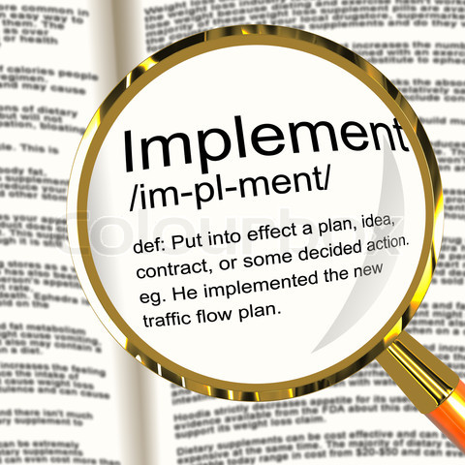
Implementation
Step 8.
Consider implementation of your
Language Access Plan.
How this will be implemented
throughout the organization (job
descriptions, employee
handbook, etc.)?

Slide 35
Implementation
Which staff members will take responsibility for what tasks?
Helpful to have a definitions section for terms such as meaningful access, interpreter, translation.
Are there other policies that you need to establish?

Slide 36
Staff Training
Step 9.
Now that your plan is
developed and policies,
protocols and
procedures updated,
make sure your staff is
familiar with and
trained on your
language access plan.

Slide 37
Staff Training
Comprehensive – relevant law, organizational assessment, language access plan, relevant policies, protocols and procedures and what to do when an unexpected language is encountered.
Proper way to communicate with a survivor using an interpreter, and practice doing so.
Clear guidelines prohibiting the use of family members, children and other participants as interpreters.
Mechanism for training new staff as they are hired, and refreshers as circumstances change or new tools or resources are identified.

Slide 38
Reflection: Language Access Plans
How have you worked to develop mutually beneficial partnerships with culturally specific organizations to enhance language access for survivors? How could these efforts be strengthened?
Specifically, how do you and your partners measure progress? What are the benchmarks you’ve established?
How are staff trained and supported to utilize the plan in their day-to-day work? How will you know if they are successful?
Notes:
Possible small group discussion questions – edit as needed

Slide 39
Community Outreach
Step 10.
How will you notify
survivors with LEP
of their rights
to language access and
the services you have
available to them?

Slide 40
Community Outreach
Be inclusive. Invite culturally specific organizations to meet to discuss the services available and to assess the barriers to services for those communities.
Build relationships with allies in the community.
Hold community informational workshops on topics important to community members, i.e. healthy relationships, legal remedies, healthy child development, etc.
Create a PSA to be featured on culturally specific radio stations or public access stations.
Go to where community members are: churches, hair salons, laundromats, schools, community centers.
GO TO WHERE THE COMMUNITY IS. DON’T EXPECT THEM TO COME TO YOU.

Slide 41
Reflection: Language Access Plans
How do you help your partners provide accurate, consistent messages about help that is available to survivors with whom they interact? How do they help you do the same?
How does the organization’s LAP reflect an understanding of where in the community survivors with LEP show up? How does it reflect your awareness of the unique challenges they face?
How does the plan reflect an organizational commitment to being accountable to culturally specific groups for successful expansion of access to services and supports?
Notes:
Possible small group discussion questions—edit as needed

Slide 42
Monitoring and Compliance
Step 11.
Now that you have a comprehensive plan to provide meaningful language access to survivors with LEP, follow up with a built-in plan to monitor the implementation.
Involving culturally-specific organizations, community partners and survivors themselves will result in a deeper understanding of how successful you have been and where you want to go next.

Slide 43
Monitoring and Compliance
Establish an annual review of your plan.
How have demographics changed?
How has your plan affected services?
How did you respond to language needs as they arose?
How do you address unexpected languages?
What should you adapt or change for next year?
How are you building capacity in the long-term, i.e. fundraising, participation satisfaction, staff hiring and training, etc.?
Utilize listening sessions, surveys, interviews and other feedback tools to gather information on how LEP survivors feel about the services they received and their ability to fully access those services.

Slide 44
(Part 3) Working with Interpreters and Promising Models Learning Objectives -- Participants will:
Work effectively with interpreters.
Describe promising practices for creating language accessible programs.

Slide 45
Working with Interpreters

Slide 46
Modes of Interpretation
Simultaneous – The process of orally rendering one language into another language virtually at the same time that the speaker is speaking.
Consecutive – The process of orally rendering one language into another language after the speaker has completed a statement or question.
Sight Translation – The rendering of material written in one language into spoken speech in another language
Notes:
After this slide demonstrate effective interpretation

Slide 47
Bilingual staff and interpreters
Bilingual staff
Interpreters
Fluent in English and native language
Not a conduit or neutral party
No government standard, but recommends assessment
Spoken language from one language to another
Training
Neutral party
Fluency in English and native language
Conduit to communicate
In-person
Telephonic

Slide 48
Bilingual Staff as Interpreters
Are you fluent in English and the foreign language?
Are you able to interpret in the consecutive or simultaneous mode accurately?
Are you familiar with legal terminology and specialized terminology of domestic violence & sexual assault in the source language?
Can you avoid a conflict of interest or the appearance of a conflict of interest between you and your client?
Can you stay in the interpreter’s role and avoid functioning in the advocate’s role?
Will the client/judge be confused by your change of roles?
Could you be a potential witness in the case?
Will you be interpreting for your client and not the batterer?
Will interpretation by bilingual advocate void the attorney-client privilege?
Will waiting for a qualified interpreter negatively affect a victim’s immediate safety?
Will your safety be jeopardized?

Slide 49
Bilingual staff -- assessing fluency
Interagency language roundtable self assessment
Having other bilingual staff or partners assess
Using glossaries and dictionaries
Using articles and texts in the target language
Paying for a professional assessment

Slide 50
Fluency Assessment
Listening 3 (General Professional Proficiency) Able to understand the essentials of all speech in a standard dialect including technical discussions within a special field. Has effective understanding of face-to-face speech, delivered with normal clarity and speed in a standard dialect on general topics and areas of special interest; understands hypothesizing and supported opinions. Has broad enough vocabulary that rarely has to ask for paraphrasing or explanation. Can follow accurately the essentials of conversations between educated native speakers, reasonably clear telephone calls, radio broadcasts, news stories similar to wire service reports, oral reports, some oral technical reports and public addresses on non-technical subjects; can understand without difficulty all forms of standard speech concerning a special professional field. Does not understand native speakers if they speak very quickly or use some slang or dialect. Can often detect emotional overtones. Can understand implications.

Slide 51
Interagency Language Roundtable Self-Assessment
I can understand basic directions and instructions, such as how to get to a local store.
I can understand uncomplicated stories about current, past and future events.
I can accurately follow all conversations among native speakers who are speaking at a normal rate of speech.
I can carry out any job assignment as effectively as if in my native language.
I can fully understand all forms and styles of speech. This includes slang, jokes and puns.

Slide 52
Qualified Interpreter
Speak with proper pronunciation, diction, and intonation in all working languages
Ability to listen to and comprehend various regional accents and/or dialectical differences in all working languages
Following interpreter ethical standards
Proficiency in English and interpreted language
Can interpret using either the consecutive or simultaneous modes of interpretation
Knowledge and use of a broad range of vocabulary, subject-specific terminology, and slang
Knowledge and use of cultural nuances, regional variations, idiomatic expressions, and colloquialisms in all working languages

Slide 53
Code of Ethics and Professional Conduct
Accuracy and Completeness
Representation of Qualifications
Impartiality and Avoidance of Conflict of Interest
Professional Demeanor
Confidentiality
Restriction of Public Comment
Scope of Practice
Assessing and Reporting Impediments to Compliance
Duty to Report Ethical Violations
Professional Development

Slide 54
Assessing Interpretation Ability
Certification or registration?
Records of community trainings or volunteer trainings?
Assessing the interpretation skill without certification
Identify the skill level needed
Have bilingual staff assess
Use glossaries and dictionaries
Use articles and texts in the target language
Pay for a professional assessment

Slide 55
Vetting and Preparing the Interpreter
Organizational Qualifying Questions and experience, credentials and references
Get a sense of their ability to absorb new material and to respond to potential problems
Is the person educated in both languages? Have they worked in both languages? In what circumstances?
Review interpreter role, ethics, protocols, note-taking, dictionary, oath
What mode will be needed for that event? Are there any forms that they will need to sight translate?
Relay interpreting
Observe any first time interpreter even they are certified. Debrief after with the interpreter. Get feedback from the judge or attorneys or advocates. Give feedback to the Interpreter Coordinator.

Slide 56
Qualifying an Interpreter is an Ongoing Process: Spotting a Bad Interpreter
Can you understand the interpreter?
Does the client look confused?
Does the interpreter appear confused?
Is the interpreter engaging in side conversations?
Is the interpreter engaging in conversations with the client before/after the interpretation meeting?
Is the interpreter summarizing?
Is everything being interpreted?
Is there a change in your clients demeanor?

Slide 57
Promising Models
Multilingual Advocate Model
The Asian Women’s Shelter supplements the language capacity of staff by recruiting bilingual women in the community as language advocates. These advocates are provided with an initial 42-hour training as well as additional ongoing trainings, support, and supervision. They are paid $15/hour and work together with staff and clients as a team, depending on the language needs at the shelter.

Slide 58
Promising Models
Minnesota Dept of Human Services “I Speak” cards

Slide 59
Promising Models
Building Interpreter and Translator Pools
Grantees have had success by recruiting and training bilingual individuals from the community to work as interpreters and translators, including students, medical interpreters, language instructors, and individuals looking for career opportunities.

Slide 60
Promising Models
Community Legal Interpreter Bank
Ayuda’s Community Legal Interpreter Bank provides affordable legal interpreters for the DC legal services community. It identifies experienced interpreters and trains them in skills needed for legal interpretation in the attorney-client setting. Interpreters are then tested to ensure their competence in the fields of their language skills, understanding of the legal system, and adherence to ethical standards.

Slide 61
Promising Models
Mobile Language Interpretation Project
AT&T donated phones to the San Francisco's Police Department that directly connect with Language Line Services. If an English-speaking Police Officer responds to a domestic violence call and discovers that the victim does not speak English, she or he will be able to use the phone to immediately access a telephonic interpreter.

Slide 62
Promising Models
United Nations Victim Translation Assistance Tool
VITA is a tool created by the United Nations using audio messages that allows law enforcement officials to provide a level of basic assistance to victims of human trafficking.
This audio tool, consisting of key encounter messages, was developed to facilitate the identification of a trafficked person and the launch of a criminal investigation. Thirty-five basic questions and messages have been recorded and translated into 40 languages, taking into account special questions for children.
http://ungift.org/knowledgehub/en/tools/vita.html

Slide 63
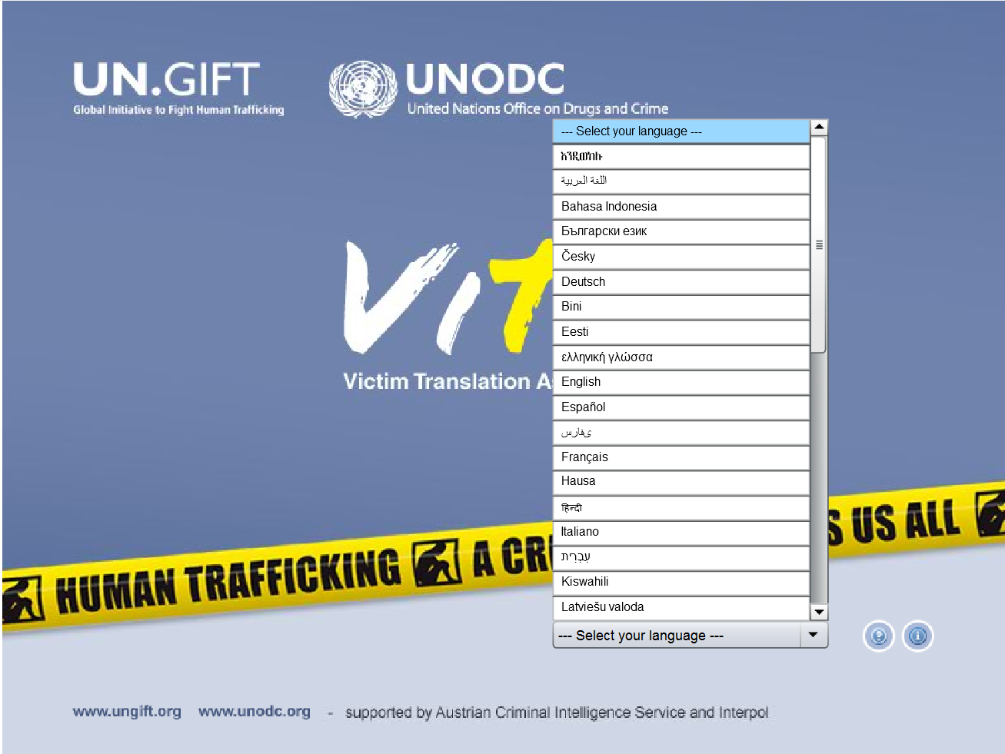
Victim Translation Assistance Tool United Nations

Slide 64
Victim Translation Assistance Tool United Nations

Slide 65
Victim Translation Assistance Tool United Nations

Slide 66
Victim Translation Assistance Tool United Nations

Slide 67
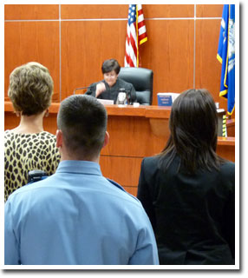
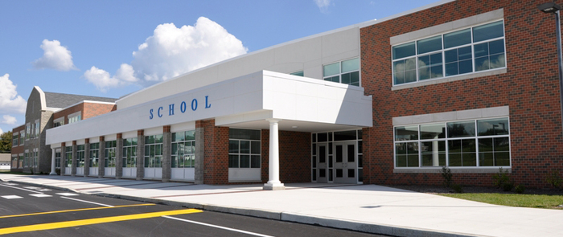
(Part 4) Systems Advocacy Learning Objective -- Participants will:
Advocate effectively for language access for survivors with other systems.

Slide 68
Systems Advocacy
In the systems advocacy work that you are already doing, what have you learned that can be applied to advocacy efforts for ensuring language access for survivors?
What do you anticipate may be unique about systems advocacy efforts to create meaningful access for survivors with LEP?
Notes:
Small group discussion (15 min): Discuss questions, capture on flip chart paper. Large group does gallery walk to see what other groups discussed.
Then facilitate a large group discussion focused on helping participants to anticipate training and TA needs.

Slide 69
Rationale
Our work happens within contexts.
Needs of survivors are multifaceted, which means they will encounter different agencies.
Advocates cannot effectively do their job if they operate in systems that are not accessible.
By committing your organization to systems advocacy, you will not only provide better services but also build your staff’s capacity.

Slide 70
Story of Deisy Garcia
Deisy lived in Queens, NY and filed multiple police reports with the NYPD claiming that she feared that her husband would kill her and her daugthers.
Deisy had spoken with the NYPD in Spanish and filed her reports in Spanish as well. Her complaints were never translated into English and as such, there was no further review of her complaints.
Three complaints were filed by Deisy, and none of the times she filed a complaint did police actually arrest her ex-husband. In January 2014, Deisy and her two daughters were murdered.
http://www.cnn.com/2014/02/19/us/new-york-domestic-killing-warnings

Slide 71
Systems Advocacy for Meaningful Access for Individuals with LEP
Ensuring meaningful language access should be part of a coordinated community response:
Courts
Prosecutors
Police
Hospitals
Social service providers
Among DV/SA service providers
Notes:
There are many services providers that are working in your community to address language access. Who are they, and how can you work with them? You don’t have to do this work alone.
Identify individuals within systems that can influence change within the system. Who can make change happen? Who has leverage?

Slide 72
Who is Responsible?
Not one person, but an organizational commitment
Build capacity among a number of staff to advocate in various systems
Build the discussion into regular meetings of advocates to share knowledge and resources, and to develop next steps
Share success stories as well as challenges and resources (via email, meetings, memos, etc)
Notes:
If this is left to one individual who leaves the organization, then there is a huge vacuum. Instead, the organization needs to build a number of employees’ capacity to advocate in the many systems they encounter
Take advantage of the weekly or monthly meetings that advocates have to discuss cases and updates to share what has come up for people and resources they have at their disposal as well as “next steps” to address issues.
Share success stories as well as challenges and resources (via email, meetings, memos, etc)

Slide 73
When DO the Courts have to provide interpreters?
The DOJ Guidance states: ... [W]hen oral language services are necessary, recipients [of any federal funds] should generally offer competent interpreter services free of cost to the LEP person.
For DOJ recipient programs and activities, this is particularly true in a courtroom, administrative hearing, pre- and post-trial proceedings, situations in which health, safety, or access to important benefits and services are at stake, or when credibility and accuracy are important to protect an individual's rights and access to important services (67 FR 41455, 41462).
Notes:
With courts, focus on common goals of compliance with Title VI and local ordinances
Identify timelines for accountability
Identify a point of contact for courts for better accountability and updates

Slide 74
Court Interpreters (cont’d)
Charging LEP persons for interpreter costs or failing to provide interpreters can implicate national origin discrimination concerns.
DOJ’s Guidance goes on to note: ...At a minimum, every effort should be taken to ensure competent interpretation for LEP individuals during all hearings, trials, and motions during which the LEP individual must and/or may be present. (67 FR 41455, 41471)

Slide 75
Fostering Relationships with Courts
Language Access Coordinator
Court Administration
Clerk in charge of scheduling (call in advance of a hearing to confirm an interpreter is scheduled)

Slide 76
Fostering Relationships with Law Enforcement
Consider multiple levels of advocacy: direct services, first responders, and policy-makers
Create partnerships with officers/staff tasked to work with the same constituency you work with (i.e. liaisons to culturally specific communities; Community Safety or Outreach Officers)
Communicate with the appropriate staff in law enforcement. For example,
DV advocate or manager at the shelter with the Supervisor of DV/SA Advocates
ED with the Precinct Officer
Notes:
Multiple levels: people who work in direct services, people who are first respondents, and people who can influence policy.
Create partnerships with officers/staff tasked to work with the same constituency you work with
Officers tasked with culturally specific communities (liaisons): Community Safety Officers; Liaison to the X community; Outreach Officer, etc
Officers or staff with direct services role (DV/SA Advocate)
Supervisor of DV/SA Advocate; Supervisor of street/patrol officers;
Precinct Officer who has power to influence policy
Make sure that the partnerships are done cross-organizationally. The DV Advocate manager at the shelter could communicate with the Supervisor of DV/SA Advocates at the police department but not necessarily with the Precinct Officer. The ED would communicate with the Precinct Officer.

Slide 77
Fostering Relationships with Hospitals
Interpretation Coordinator or Language Access Coordinator
Nursing management
Foundations of hospitals – does your organization have a connection that will be helpful?
Notes:
Nursing management because they spend significant time with patients
Maybe someone from your board knows people in the foundation.

Slide 78
Fostering Relationships within Child Protective Services
DV advocates working within the agency (not in all areas)
Front-door staff (i.e. an investigation supervisor or manager)
Bilingual social work staff/case managers and their supervisors
Local office directors and managers
State level Diversity Coordinator, Language Access Coordinator
Ombudsman’s Office when problems arise or a complaint needs to be filed
Notes:
Similarly, in a Welfare or Public Benefits Office, look for a DV liaison, intake supervisor, and case workers.

Slide 79
How to File a Complaint
If a recipient of federal funds continues to deny meaningful access to LEP individuals a complaint can be filed.
Develop an organizational process for determining when to file a complaint.
The Coordination and Review Section of the Civil Rights Division of the U.S. Department of Justice handles complaints.
http://www.justice.gov/crt/cor/complaint
Notes:
Cover local, state and federal complaints –this is a form of advocacy!

Slide 80
With Partners
Develop cross-system protocols and procedures for maximizing language access to safety and services.
Include partners in outreach as you publicize your LEP access plans.
Include LEP access information in cross-systems trainings, or advocate to be able to provide training.
In collaborative efforts with other systems (multi-disciplinary teams, high risk case review teams, etc) attend specifically to language access issues of survivors and their children.
Notes:
In collaborative efforts, spend time deconstructing your successes -- to build practice wisdom for the future.
Share your (human) LEP resources with caution -- do not give other systems a ‘pass’.
Be prepared to deal effectively with perceived lack of resources or outright resistance.

Slide 81
Messages to Partners: Ensuring Quality of Language Access
Accuracy and effective communication are critical in domestic violence situations.
Do not rely on friends and family members to interpret for the LEP victim in important and sensitive interactions. Avoid using children as interpreters, especially in domestic violence cases.
Being bilingual is not enough; interpreters should be trained, neutral, and abide by confidentiality and ethical standards.
Important to ensure that vital documents are translated into the non-English language of each regularly encountered LEP group.

Slide 82
Join or Create a Language Access Coalition
Identify allies that are working on, or need to be working on, language access.
Ensure shared understanding of Title VI and related federal requirements.
Ask each member organization/system to identify a point person on language access.
Share Language Access Plans.
Schedule regular meetings.
Identify goals, timelines, responsibilities.

Slide 83
Language Access Coalitions: Goals
Collaboration of culturally specific organizations and staff of systems and provider agencies, for:
Exploring cultural barriers to accessing systems and services.
Information and story gathering to inform advocacy and language access planning.
Sharing of successful language access efforts.
Connecting to local trainers and organizations to provide in-person, localized, language access training and assistance in planning.
Exploring options for advocacy within a community.
Notes:
Cultural context is intricately intertwined with language.

Slide 84
Get Help – Tap into Resources
ITARC
National Language Access Advocates Network
Other grantees

Slide 85
TRAINER DISCUSSION
What challenges are you anticipating as you help member programs and their partners expand systems advocacy efforts to address the needs of survivors with LEP?
What additional supports or materials would be most helpful to your member programs in these efforts?
What additional conversations would be helpful to your efforts to enhance language access at the state level?

